Slide 1
NUTROPLAN (NUTRITIONIST MANAGEMENT SYSTEM)
İstanbul Bilgi Üniversitesi
Fall, 2023
Hasan Hüseyin Kalay-120200077
Murat Can Önder-119200089
Alp Yıldırım-119200046

Slide 2
Contents
•Introduction
•User Management
•Appointment Schedule
•Customer Profile (Patient Data)
•Diet Programs
•Report and Analysis (Graph)
•Education Information
•Implementation Programs
•Project Team
•Conclusions
•References

Slide 3
“The doctors of the future will no longer treat the human frame with drugs, but rather will cure and prevent disease with nutrition.” – Thomas Edison

Slide 4

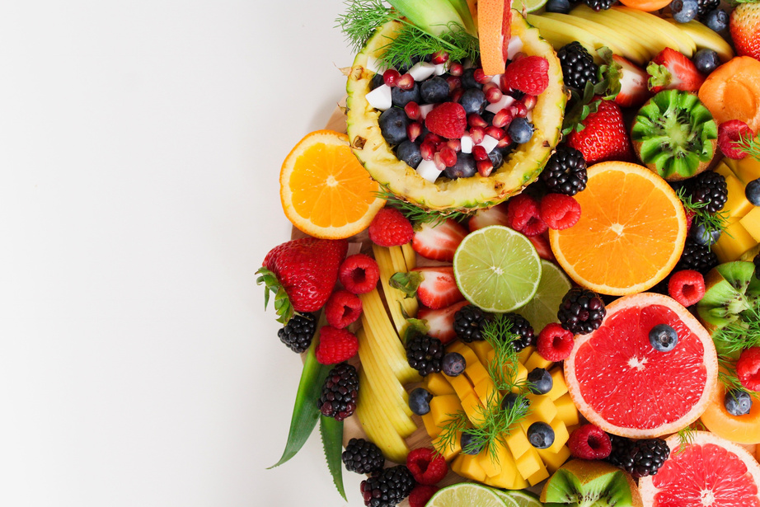


WHAT IS NUTROPLAN?
NutroPlan
The NutroPlan is an application specifically designed for the use of dietitians.

Slide 5

Problem Statement
In Turkey, the Turkish Dietitians Association (TDD) reports a total of approximately 40,000 dietitians, half of whom are independent practitioners. This translates to around 12,500 dietitian offices across the country. Currently, only 20% of these offices utilize management systems, but projections suggest an increase to 25% by 2024. This data underscores a substantial gap in the adoption of efficient management systems within the dietitian community. The evident need for a comprehensive Nutrition Management System is underscored by the expected growth in the percentage of dietitian offices utilizing such systems in the coming years.
Key Challenges:
Limited Adoption of ManagementSystems
Potential Inefficiencies in Nutrition Management
Growing Industry Demand

Slide 6

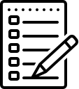
Solution Offer -Why Nutritionists Need Nutroplan?
Our proposed solution is NutroPlan, a state-of-the-art Nutrition Management System designed to address the specific needs of dietitian offices in Turkey. NutroPlan aims to bridge the technology gap by providing a user-friendly, integrated platform for efficient management of dietitian practices.
Key Features of NutroPlan:
Client Management
Nutritional Analysis
Appointment Scheduling
Data Security
Integration with TDD Guidelines
By developing NutroPlan, we aim to contribute to the modernization of dietitian practices in Turkey, fostering efficient, data-driven, and client-centric approaches to nutrition management.

Slide 7
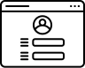
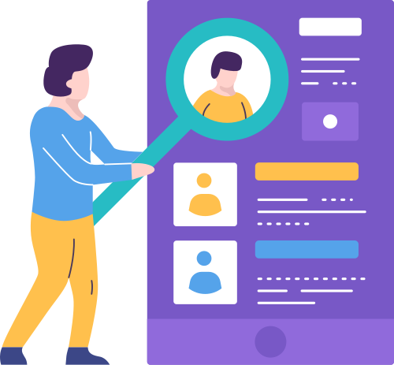
User Management
•There is a secure login system for new dietitians to register with the app and existing users to log in.
•There is an area where each dietitian can create and edit their own profile.

Slide 8
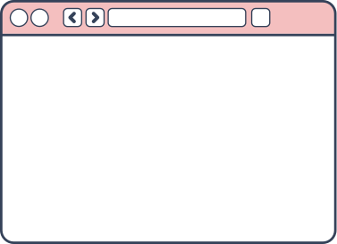
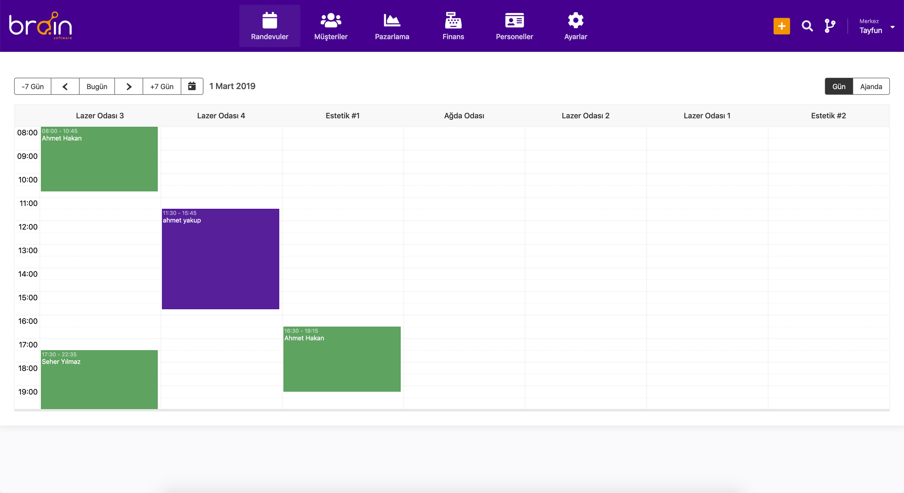
Appointment Schedule
•Dietitians can easily plan, organize and track their appointments.
•There is a user-friendly calendar feature for client appointments.

Slide 9
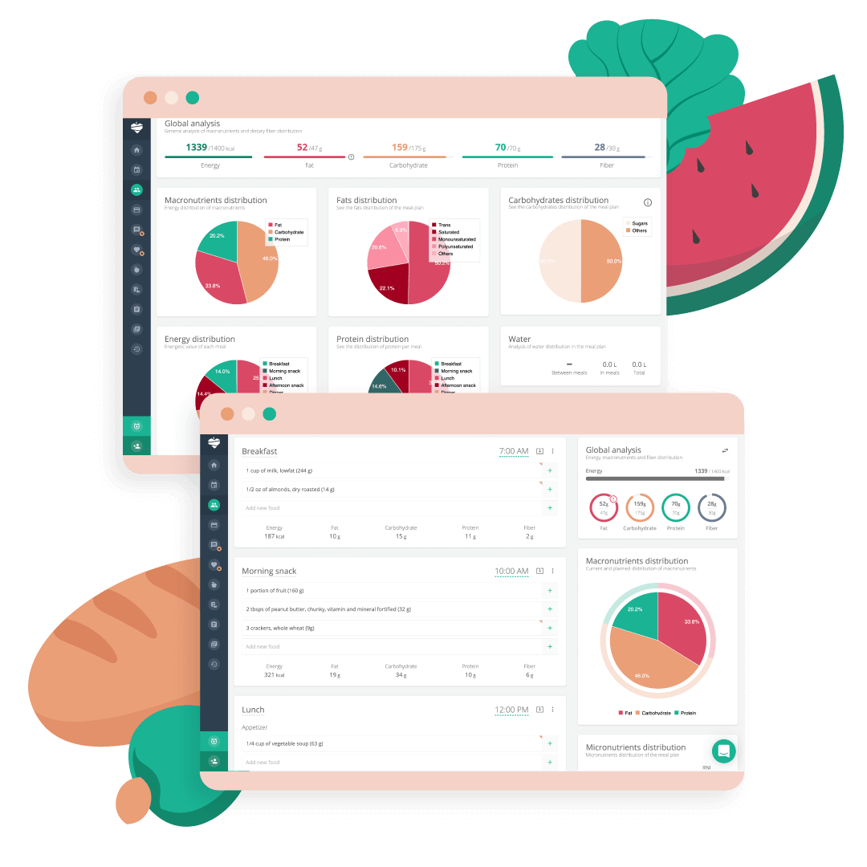
Customer Profile
•Dietitians can create and update client profiles and add custom notes.
•This section provides data storage for client-specific nutrition plans and progress tracking.

Slide 10
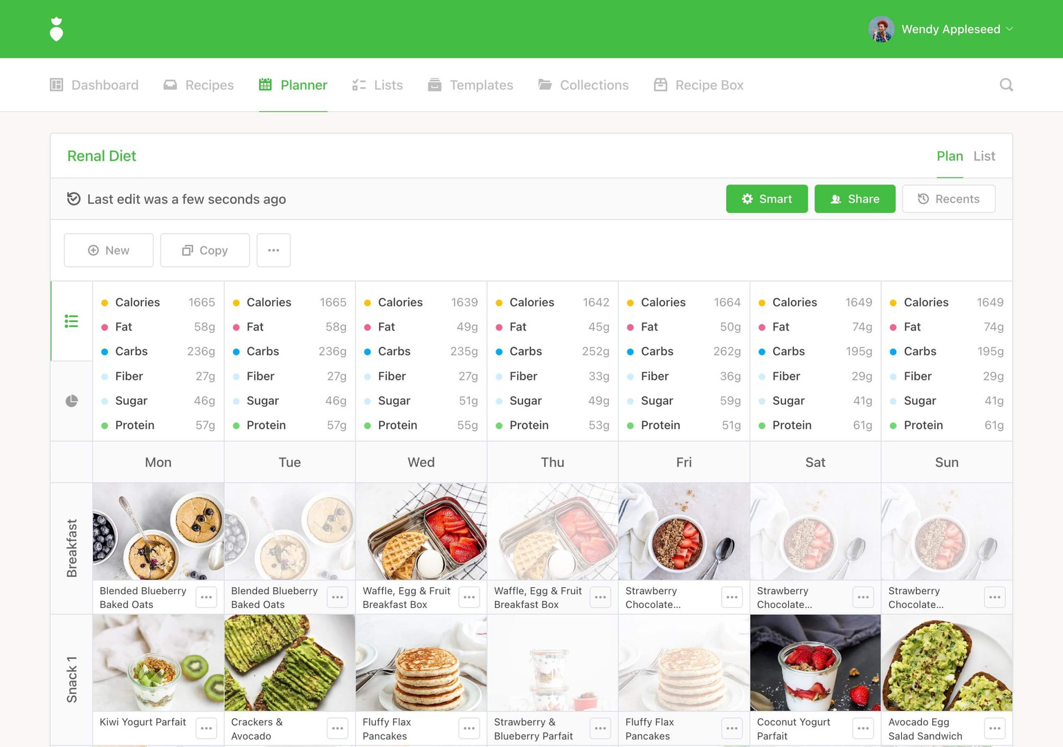
Diet Programs
Dietitians can create custom nutrition programs based on client needs, perform calorie calculations and manage nutrition plans.

Slide 11
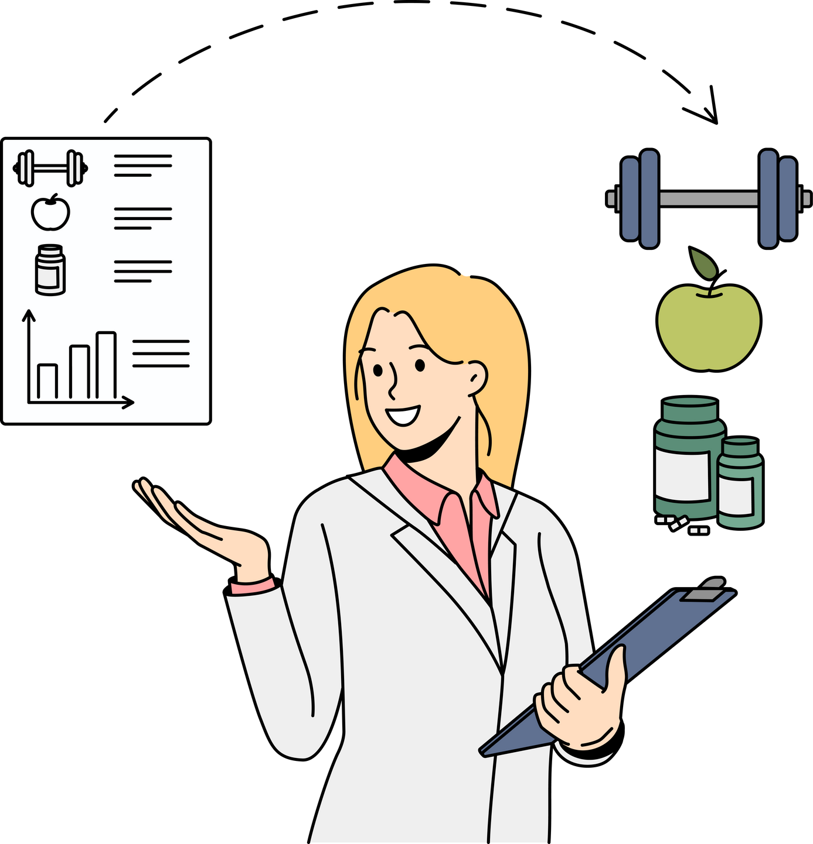
Report and Analysis
•Graphs, reports and analysis tools are offered to track customer progress.
•This section allows dietitians to follow the progress of their clients.

Slide 12
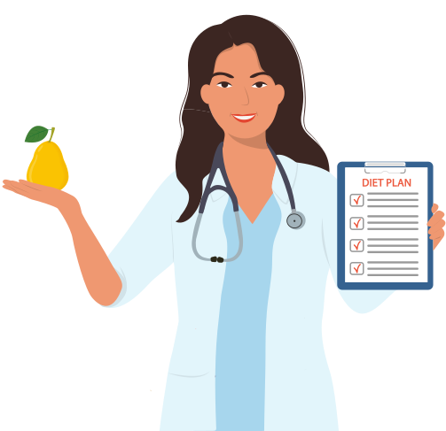
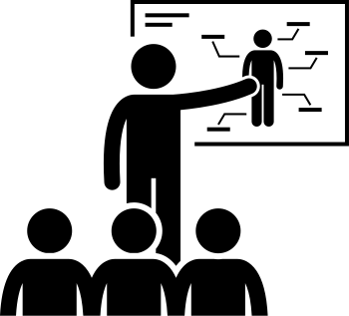
Education Information
•This feature is a section where dietitians can provide their customers with information on nutrition and health.
•Dietitians can share content such as customized articles, nutrition tips, healthy recipes, and lifestyle advice for their clients.
•It is possible to organize training videos or live seminars that can be accessed through the application.

Slide 13
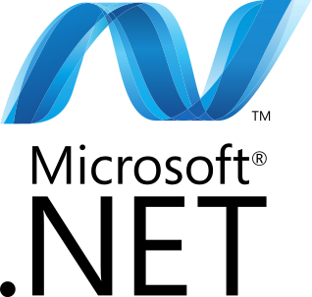
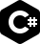
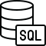

Impelementation Programs

Slide 14
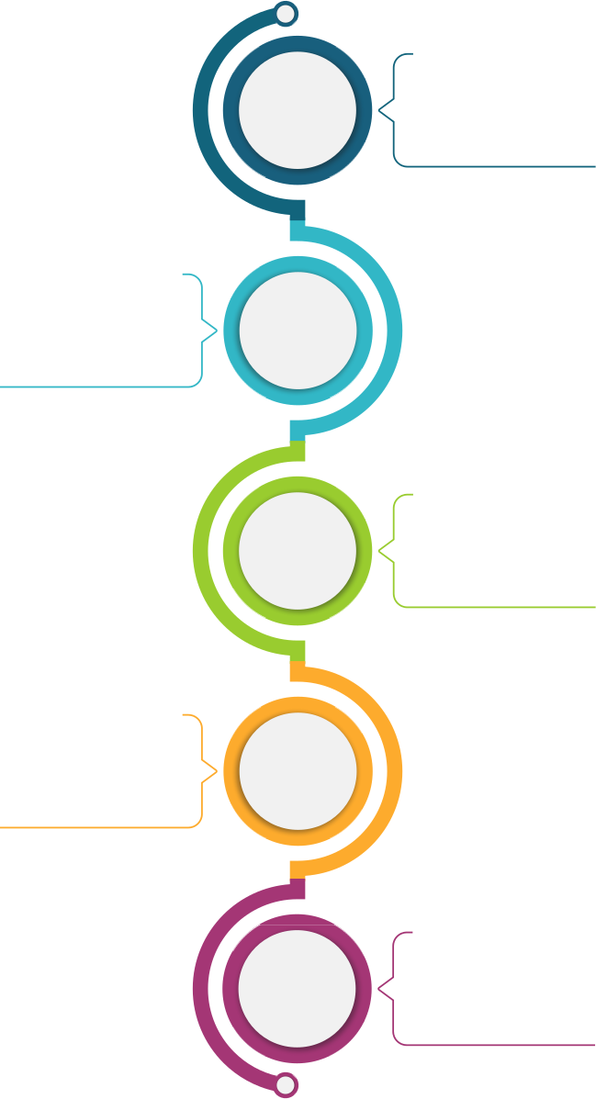
Project Timeline
Week 1-3 Kickoff and Project Planning
Week 4-6: Market Research and User Analysis
Week 7-10: System Architecture and Design
Week 11-15: Frontend and Backend Development - Phase 1
Week 16-..: Full System Development

Slide 15
PROJECT TEAM
Murat Can Önder
Contact Information
can.onder02@bilgiedu.net
Role: Database Design, Tester
Hasan Hüseyin Kalay
Contact Information:
hasan.kalay@bilgiedu.net
Role: Backend Development
Alp Yıldırım
Contact Information:
alp.yildirim02@bilgiedu.net
Role: UI Design,
Tester

Slide 16
Conclusion
•In conclusion, the Dietitian Management Application is a platform that aims to optimize dietitians' workflows and strengthen customer relations.
•The user-oriented interface and various features of the application will help dietitians provide a better service to their customers.

Slide 17
References
https://www.tdd.org.tr/
Jennings J, et al., editors. Managing Successful Nutrition Programmes. Geneva: ACC/SCN; 1991. (State-of-the-Art Series, Nutrition Policy Discussion Paper No. 8)
https://www.nutritics.com/en/food/labelling
https://www.dmd-guide.org/gastrointestinal-management/nutritional-management/
https://www.sciencedirect.com/topics/food-science/nutritional-management
https://www.platejoy.com/
https://fdc.nal.usda.gov/

